Slide 1
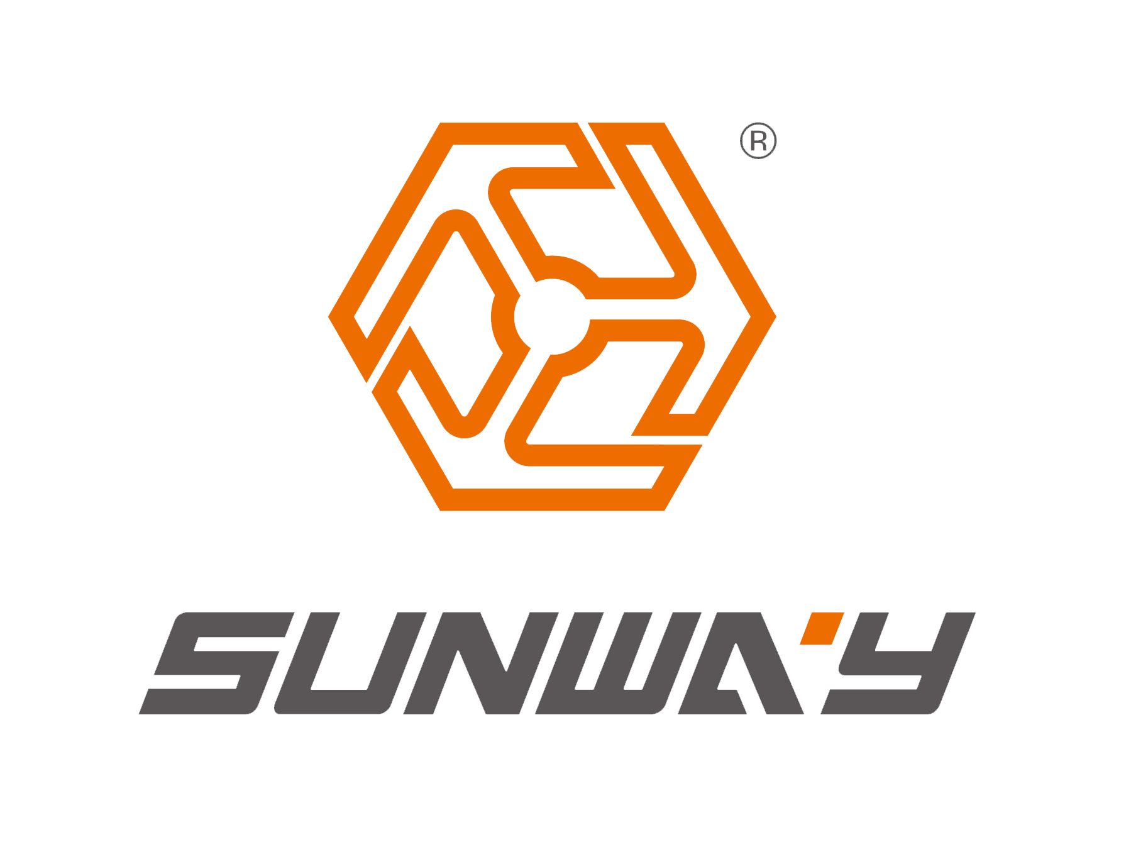
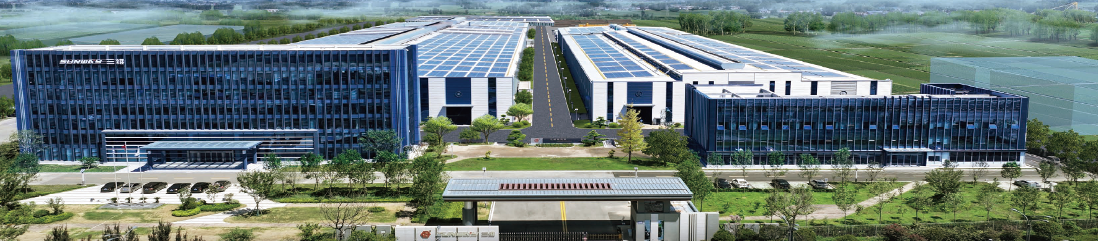
SUNWAY 简介
Sunway Steel Building--A integrated national high tech enterprise of technical consulation, solution advice, production&construction, specializing in light&heavy steel structure engineering, and is the first public enterprise listed in NEEQ in Tengzhou City with stock code: 832621.
Sunway Heavy Steel Structure---Specializing in customized equipment steel structure fabrication for Mining & Cement, Machinery, Power & Chemical plant, Construction and New energy industry
三维钢构是集钢结构技术咨询、方案提供、工程设计、制造、施工为一体的国家高新技术企业，专注于钢结构轻型、重型建筑工程；
滕州市首家“新三板”挂牌企业（股票代码：832621）
三维重工专注于：水泥矿山、工程机械、石油化工、工业化建筑部品、新能源等行业设备非标定制加工制造。
20+ years history 2 producion bases Plant area 130000㎡ Annual Capacity 150K MT
20多年 发展历程 2 大生产基地 13万㎡ 厂房面积 15万吨 加工产能

Slide 2
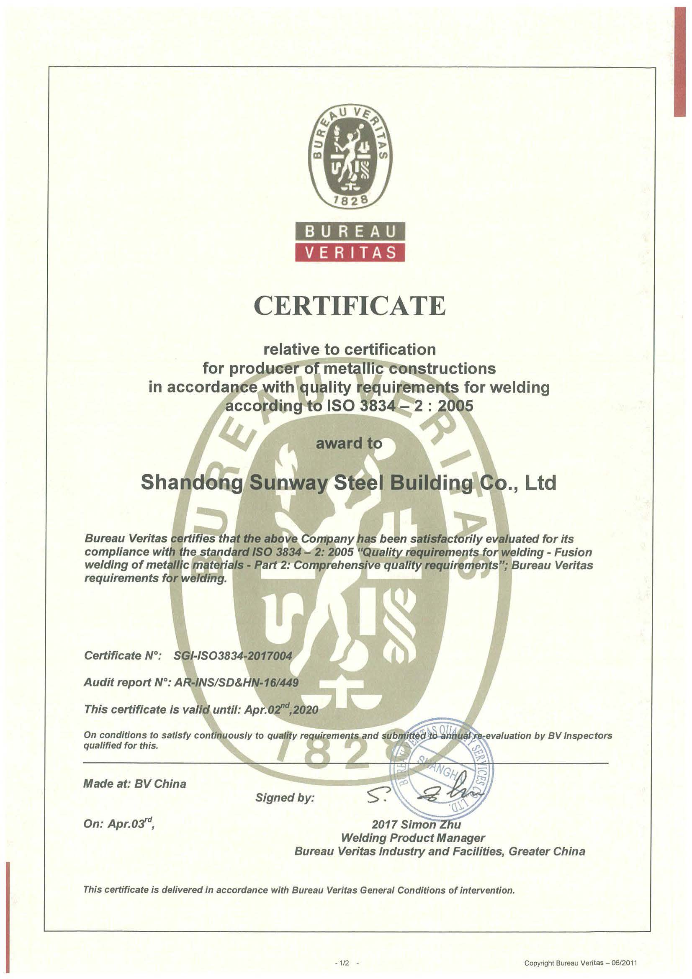
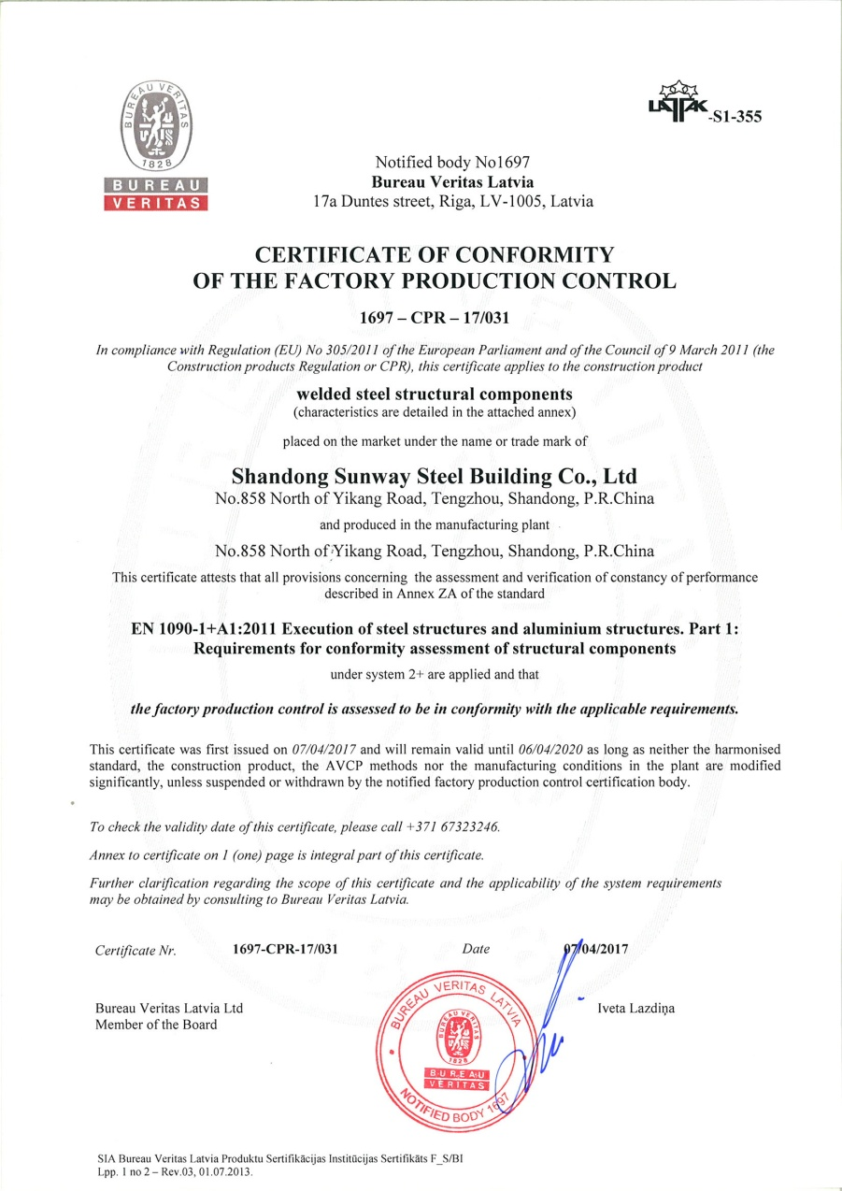
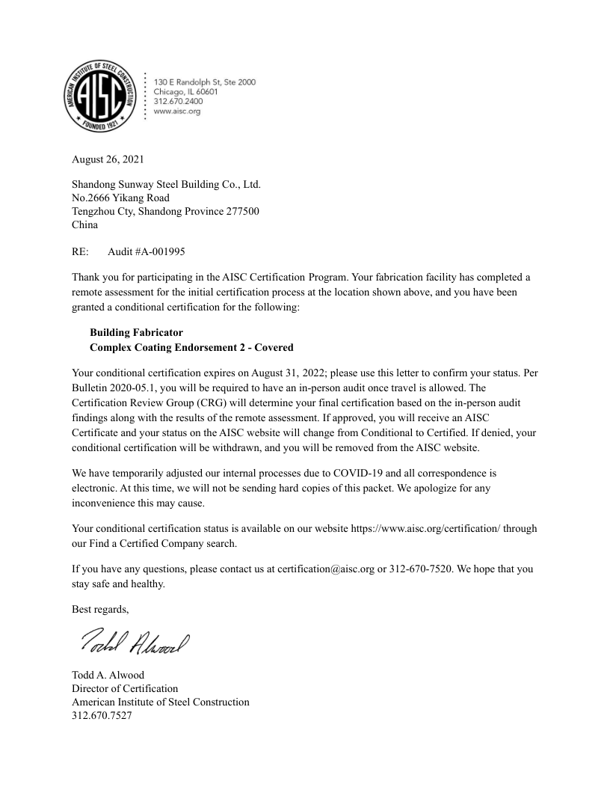
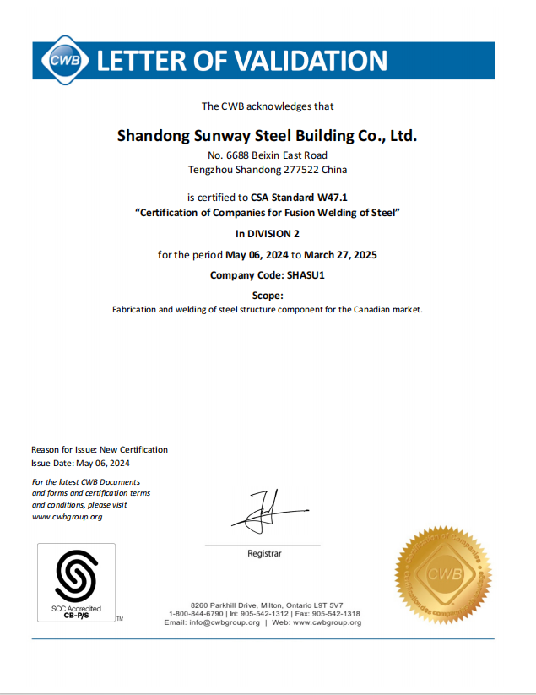
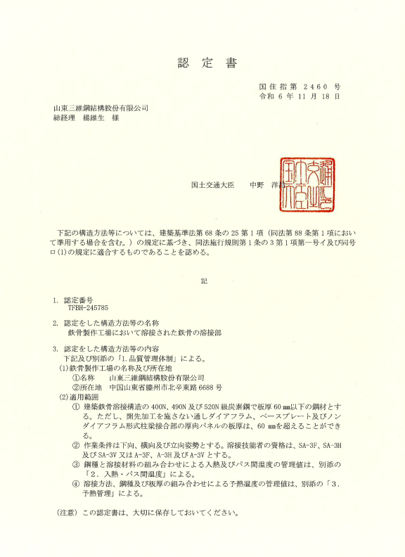
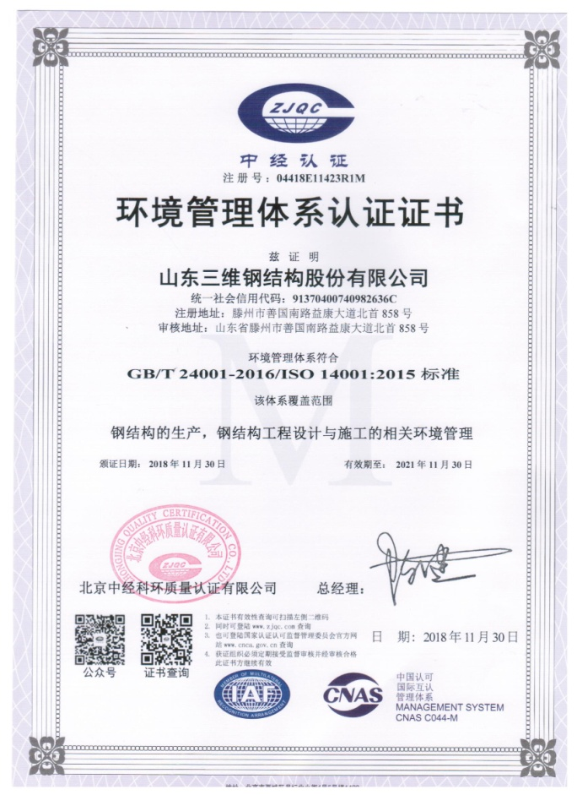
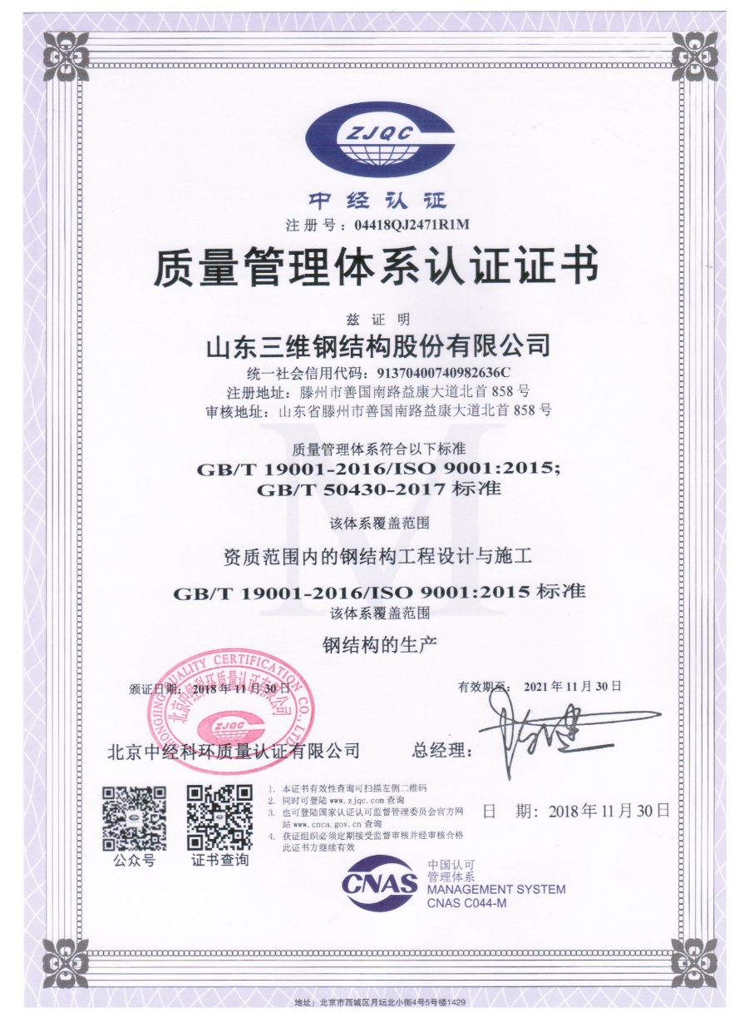
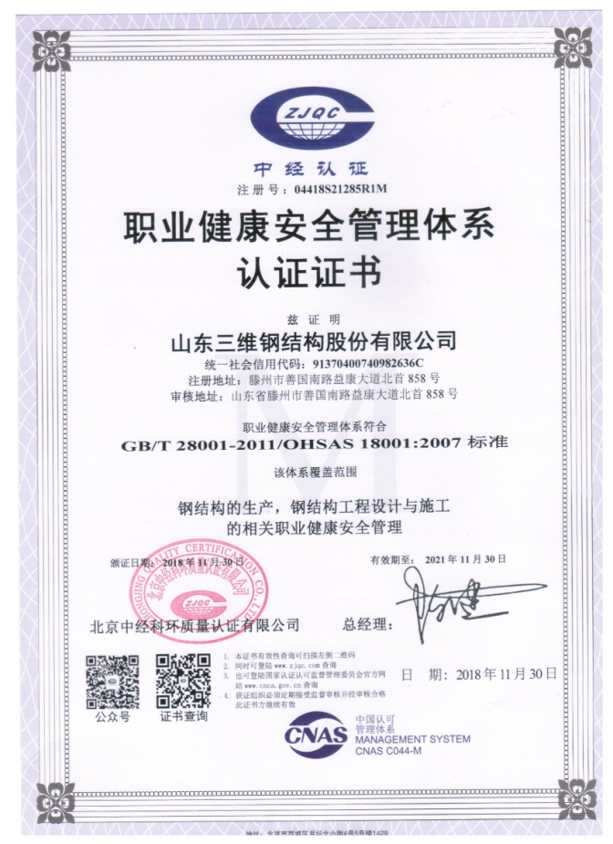
国际认证
International Certification
CWB
加拿大体系认证
ISO 9001
(质量管理体系认证)
ISO14001
(环境管理体系)
OHSAS 18001
(职业健康安全管理体系)
ISO3834
国际焊接认证
EN1090
欧盟CE体系认证
AISC
美标体系认证
JIS
日本JIS认证

Slide 3
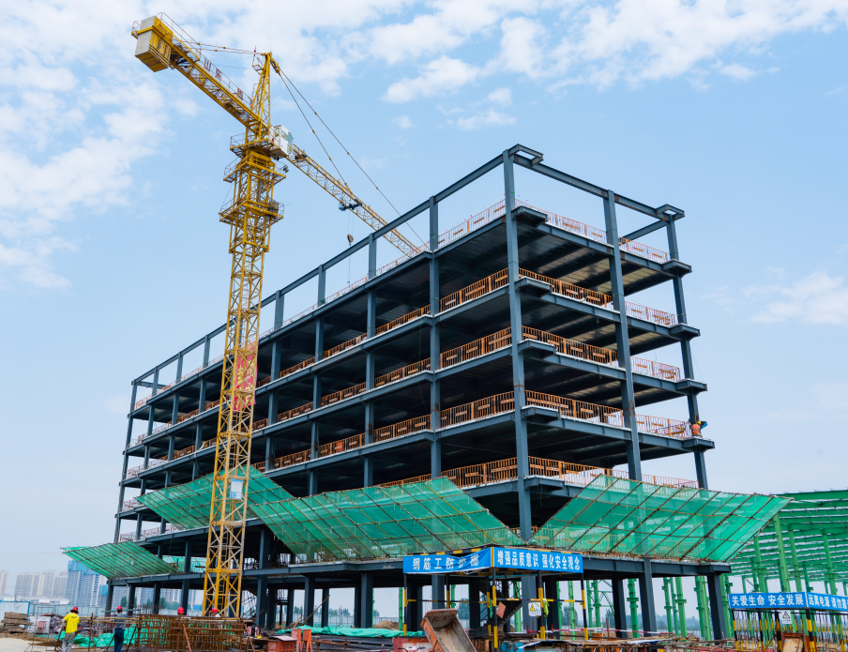
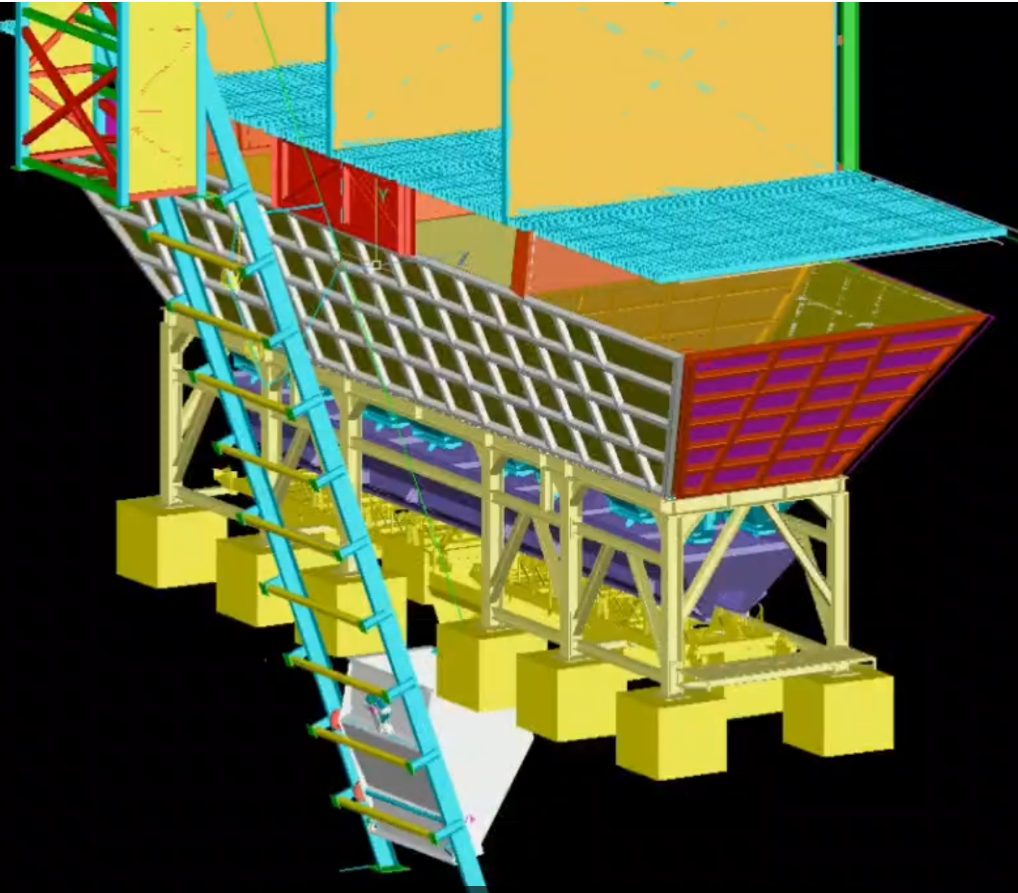
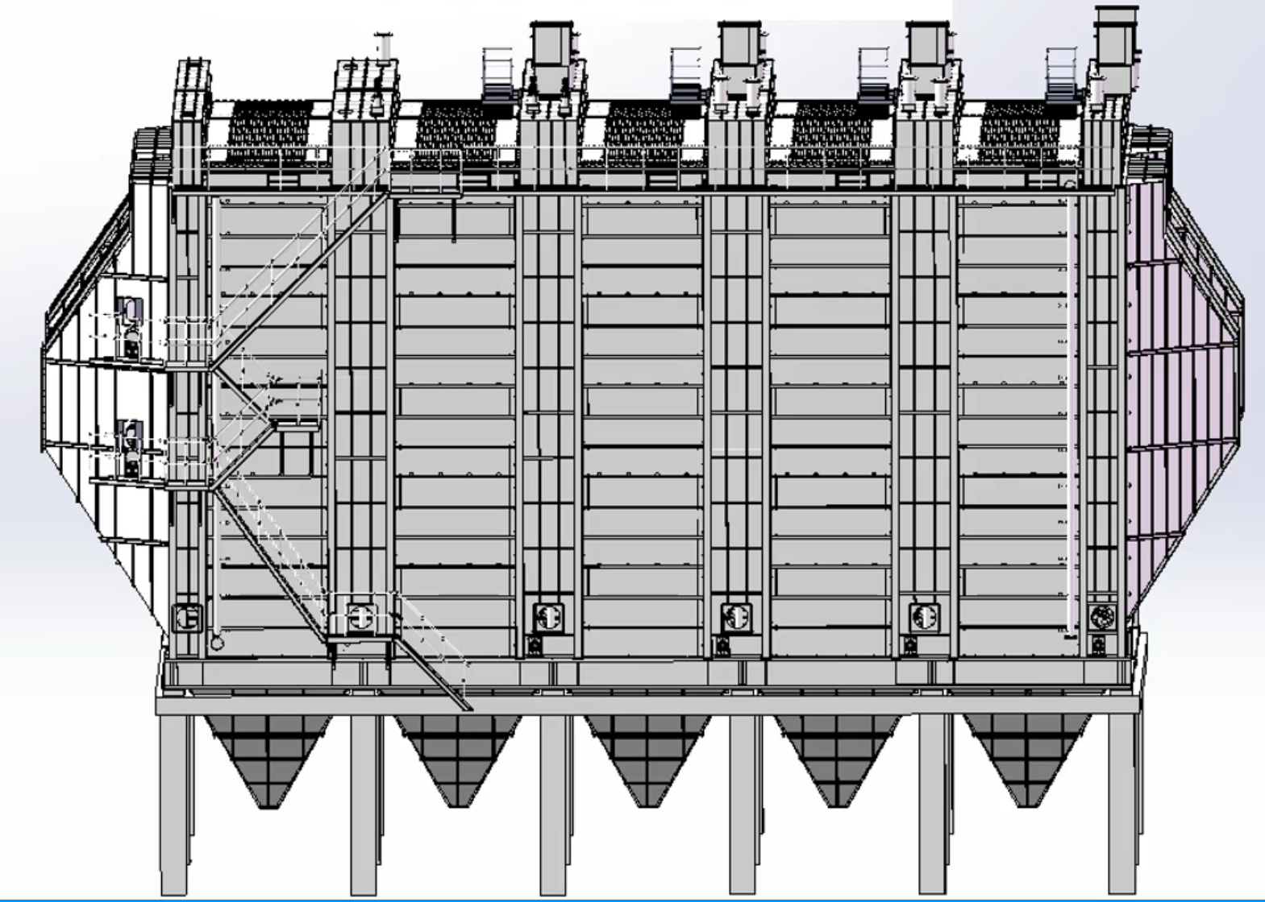
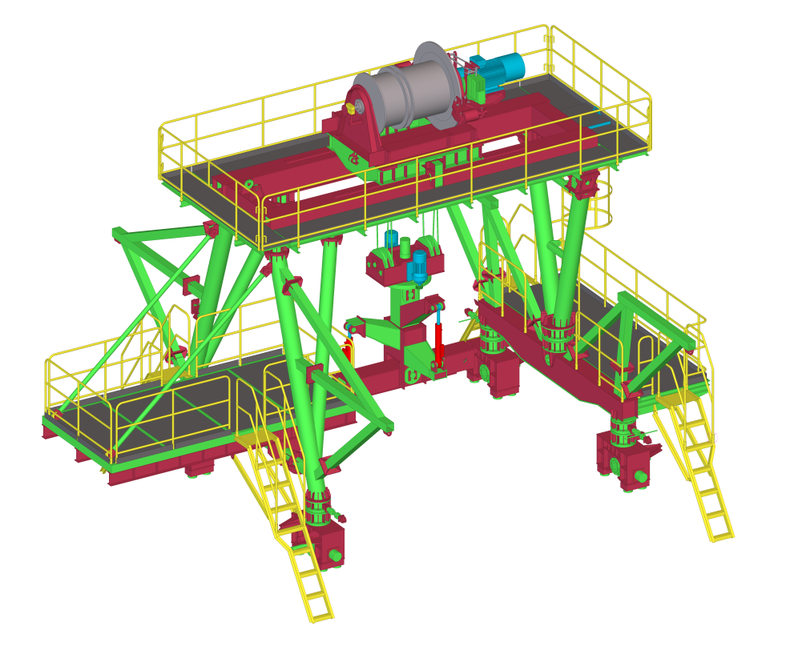
加工智造 产品品类
Smart fabrication Product category
PEB Construction
BULK MATERIAL HANDLING EQUIPMENT
Environmental Equipment
Engineering machinery
Belt Conveyor
Crusher
Stacker-Reclaimer
Silo/Hopper
Cable Gallery
Industrial plants
Multi-story buildings
Stadiums
Bridges
HRSG Structure
Dust collector
Steel Chimney
Crane
Bridge erecting machine
Notes:
Heat Recovery Steam Generators (HRSG)
余热锅炉支架
Dust Collector
除尘器
PV/CSP Structure
光伏光热支架

